Slide 1
MSAE Capstone
January 25, 2023

Slide 2
Course Overview
This course will be different from most of the others you’ve taken.
Limited lectures/ new information.
Focused on learning-by-doing.
Self-directed.
Project-centric.

Slide 3
Things to consider when choosing a project
What kind of job do you want?
What kind of skills to you want to strengthen?
Econometrics?
Economic Theory?
Coding? (Python? R? Java?)
What new skills do you want to learn?
Today: working individually and groups to organize thoughts on this.

Slide 4
Project Format
Most projects will take one of two forms:
A research paper
A portfolio project
If you have a different proposal, feel free to discuss with me.

Slide 5
Project Requirements
Answer a research question.
Incorporate tools from economics (econometrics, economic theory, or both).
Include data analysis.

Slide 6
Project Brainstorm

Slide 7
Brainstorm
Write down for yourself answers to the following:
What kind of job do you want?
What kind of skills to you want to strengthen?
Econometrics?
Economic Theory?
Coding? (Python? R? Java?)
What new skills do you want to learn?
Project ideas?
Prepare to share: skill you most want to strengthen (more specific than ‘coding’ or ‘data analysis’).

Slide 8
Project Ideas
These are just ideas! You may have better ones.

Slide 9
CA/ SF YIMBY Proposals
Stan Oklobdzija
Database of every CEQA lawsuit since 2010.
Extracting info from complaints -> network map of attorneys who file suits, or a study of which type of projects get sued?
Sonja Trauss
Relationship between parking quantities and # of households within walking distance.
How much density is needed for a corner store? A church?

Slide 10
SF Housing Data
Peter Lorentzen obtained data on housing sales over past ~10 years.

Slide 11
Safegraph COVID-19 Data
Data on human movements for studies related to COVID-19 is free for academic use until March.
Check it out here: https://www.safegraph.com/covid-19-data-consortium

Slide 12
Data and the American Dream
Matthew Holian wrote a book and shared a bunch of scripts using the IPUMS-USA data: https://sites.google.com/site/profholian/home/dad
He shares replications – you could think of other studies, make visualizations, etc.

Slide 13
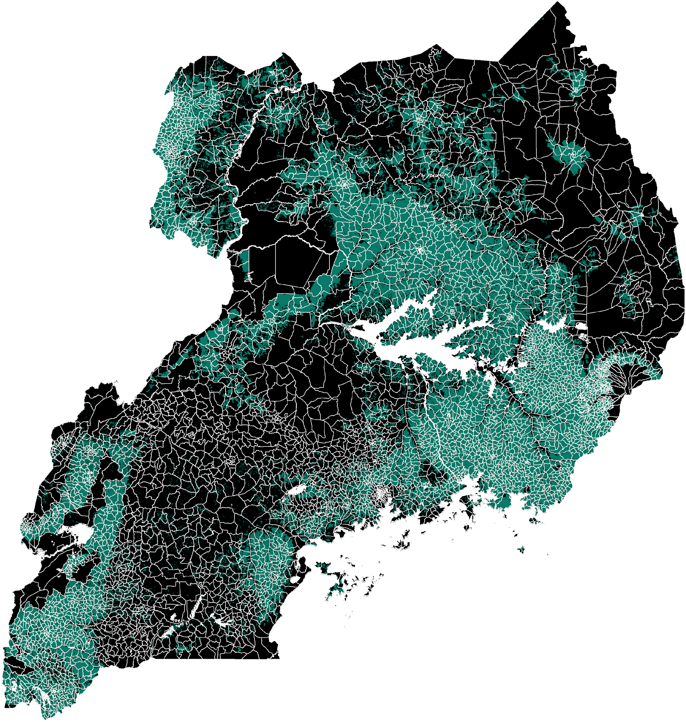
Satellite-based Agricultural Data
I use these data a lot in my research.
By linking with household surveys, can study the impact of agricultural shocks on education, health, wealth, etc.
Other interesting projects have been done using computer vision to estimate poverty etc. This sort of thing could be an interesting project.
Not limited to agriculture! That’s just what I know best.

Slide 14
Nature Conservancy Urchin Ranching
Too many purple urchins are depleting kelp forests.
Sea star wasting disease has decimated their primary predators.
TNC has developed a business plan + proof of concept for urchin ranching to restore kelp beds.

Slide 15
SPOON Foundation
Has an app that records data about babies + children, used widely in orphanages.
Lots of data on many outcomes – primary question: does positioning affect outcomes?

Slide 16
Other Data Sources
World Bank (Global)
UN Food and Agriculture Organization
American Community Survey
Harvard Dataverse
Google Earth Engine

Slide 17
Project Search

Slide 18
Group Discussions
In small groups, introduce yourselves and share your answers to each of the three questions. Ask each other follow-ups, and share ideas.
What kind of job do you want?
What kind of skills to you want to strengthen?
Econometrics?
Economic Theory?
Coding? (Python? R? Java?)
What new skills do you want to learn?
Discuss project ideas: share your current best idea with classmates.

Slide 19
Spend some time researching
Pick one or more project ideas and start investigating:
Potential Data Sources
Potential Methods
Record your ideas and what you find in canvas.

